Slide 1
GENERATING STOCHASTIC DATA TO SIMULATE A TWITTER USER
Authors: Jason Li, Abdolreza Abhari
Presented by:
Derek Popowski Aaron Johnson

Slide 2
The Problem
Testing of algorithms used to recommend new content on social networks
Limitations of using real data to test
Time
must use APIs of the system which have other limitations

Slide 3
Introduction
A few assumptions
Tweets can contain information that are relevant to other users
Similar users would have tweets about similar topics
The simulation of a Twitter network would contain real tweets
Goal
Generate stochastic(randomized) data to test the algorithms of recommender systems

Slide 4
Testing recommender systems
Gathering data from Twitter APIs is very time consuming
Some of these APIs have limitations in regard to this task
Problems for simulating this data
Verify that data generated that follows a similar distribution
Verify simulated data is clustered similar to real data
This sufficiently tests algorithms used by these systems
New simulation model must be scalable to simulate gathering data on many users

Slide 5
Related work
There are other works that aggregate tweets from a user into one document
However, the aggregated tweets are not explored to generate stochastic data.

Slide 6
Overview of Methods
Seed data
The data collected for the simulation is composed of 1000 real tweets
Collected from 10 users
Gathered over a 5-month period
Bag of words model
Cosine Similarity
K-means Clustering

Slide 7
Bag of words model
Consists of the weights of each word or term
Weights of the terms in the documents are determined by the term frequency
This alone is not enough to represent the weight of terms
Inverse document frequency
Final weight is product of the two tf-idf
log(N/df)
N = number of documents(tweets)
df = document frequency, number of documents where term appears

Slide 8
Cosine Similarity
Determine the similarity between document vectors(each ‘bag of words’)
Measures the cosine of the angle between vectors
If all the weights are equal, this angle would be zero
The value of cosine similarity falls in the range of 0 to 1
Values close to one are more similar
A ⋅ B = ||A|| ||B|| cos 𝛳

Slide 9
K-means Clustering
Aims to partition n observations into k clusters
With the goal of producing clusters with the lowest sum of squares(variance)
Normally k-means uses the Euclidean distance
In this implementation uses 1 - cosine similarity
Requires the number of clusters to be determined before starting the algorithm
used n = 3 to test
The center means are initially seeded (usually at random)
Iterates over all users and updates the center mean
complete when current iteration matches the last

Slide 10
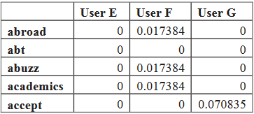
Generation of Stochastic Data
Start by processing the real tweets, calculating the tf-idf for each user for every term in the bag of words
tf-idf means “Term Frequency - Inverse Document Frequency”
It is a weight that is applied to any given word in the bag of words
Create a matrix of the resulting tf-idf values

Slide 11
Generation of Stochastic Data (cont.)
Take any user from the matrix, order their bag of words by the tf-idf value ascending
Generate a random value from a Weibull distribution and ensure it is within the range of possible tf-idf values for this user
Weibull was chosen based on best fit
Gamma distribution was closely looked at
Find the tf-idf most closely matching the random value
Get its associated word
This word is used as the first word in the stochastic tweet from this user!
Process repeats 3 - 7 times
Minimum words per tweet must be 3 to be considered useful
Average number of words per tweet in set of real tweets is 7
Figures come from empirical data collected prior

Slide 12
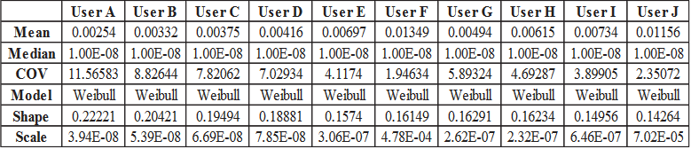
The Weibull Distribution
Probability distribution
Requires two parameters
Shape parameter
Scale parameter
Supports a single random variable
This is the tf-idf value

Slide 13
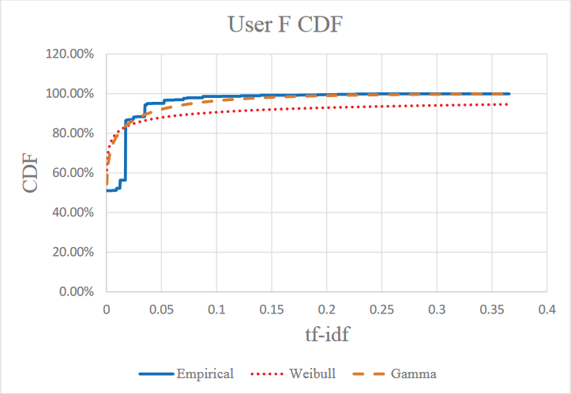
The Weibull Distribution (cont.)

Slide 14
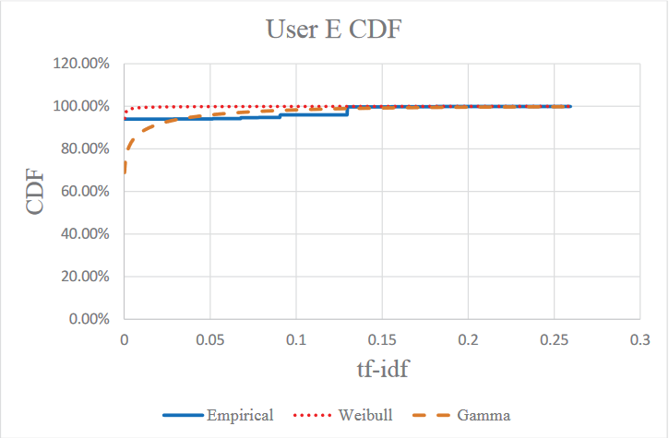
The Weibull Distribution (cont.)

Slide 15
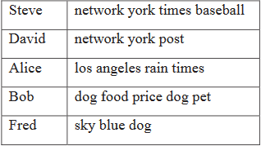
Example of Stochastic Tweets
Notice the lack of correct grammar and relative lack of sense

Slide 16
Recommender System Simulator
Created to test clustering of both real and artificial data
Artificial data comes from stochastic tweets
Clustering is performed
After each word for each tweet for each user is given a tf-idf value
Using this stochastic data, choose to start with 3 clusters
K-means will randomly assign 3 of these tweets as the initial seed
For this example, we will select the tweets of Steve, Alice, and Fred
The centroid document vectors will conduct cosine similarity with the document vectors of David and Bob
After assigning tweets of David and Bob to a cluster, we update the centroid tf-idf weights with the average of the words in the cluster
Process repeats until no new tweets are left

Slide 17
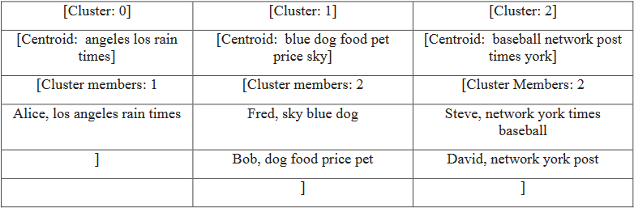
Recommender System Simulator (cont.)
Example of clustering results

Slide 18
Recommender System Simulator (cont.)
After clustering, we can choose a user to receive recommendations
We’ll choose Fred for example
Fred receives recommendations based on cosine similarity between his document vector and the other users’
Document vectors in the same cluster as Fred will receive a higher recommendation score

Slide 19
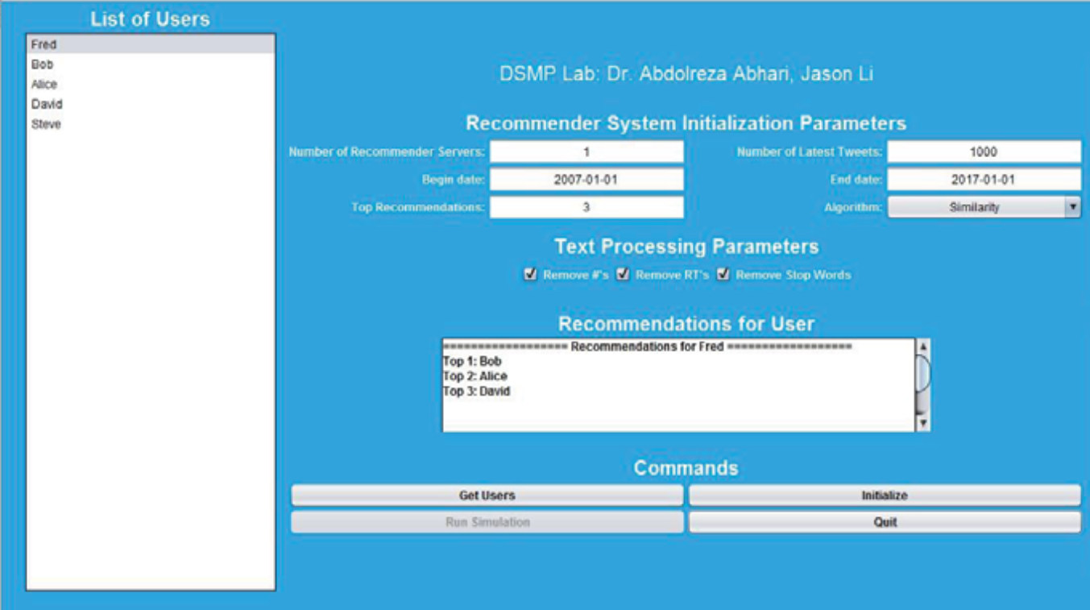
Recommender System Simulator (cont.)

Slide 20
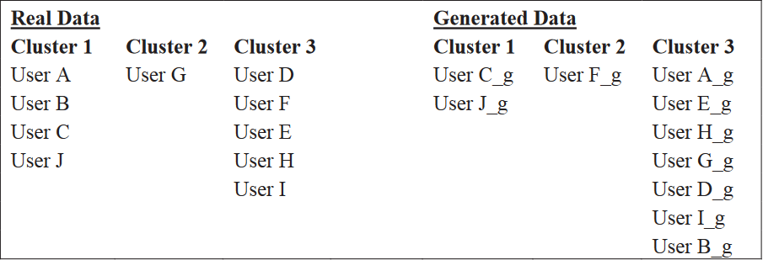
Real Tweets v.s. Stochastic Tweets
Recommender Simulator was run with real data and stochastic data, then compared
_g users indicate users with stochastically generated data
Initial seeds for both datasets were Users B, D, and E (_g users for generated data, respectively)

Slide 21
Conclusions
Distribution of words in a collection of tweets by a user is closely represented by a Weibull distribution
Stochastic data is able to be clustered similarly to real data
Promising results, may be scaled to millions of stochastic tweets
The model proposed can be used to generate massive amounts of stochastic data
This data can be used to effectively test and improve recommender systems
Real Twitter users may receive accurate recommendations for who they may like to follow based on improvement of recommender systems

Slide 22
References
Abhari, A., & Li, J. (2017, June 15). Generating Stochastic Data To Simulate a Twitter User.
Retrieved September 9, 25, from
http://scs.org/wp-content/uploads/2017/06/15_Final_Manuscript-2.pdf

Slide 23
Questions?

